Slide 1



Multiple Access
McGraw-Hill
©The McGraw-Hill Companies, Inc., 2000

Slide 2
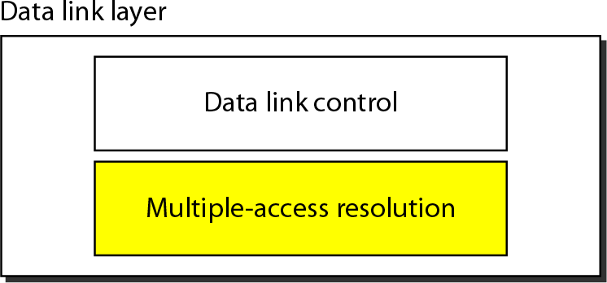
Data link layer divided into two functionality-oriented sublayers

Slide 3
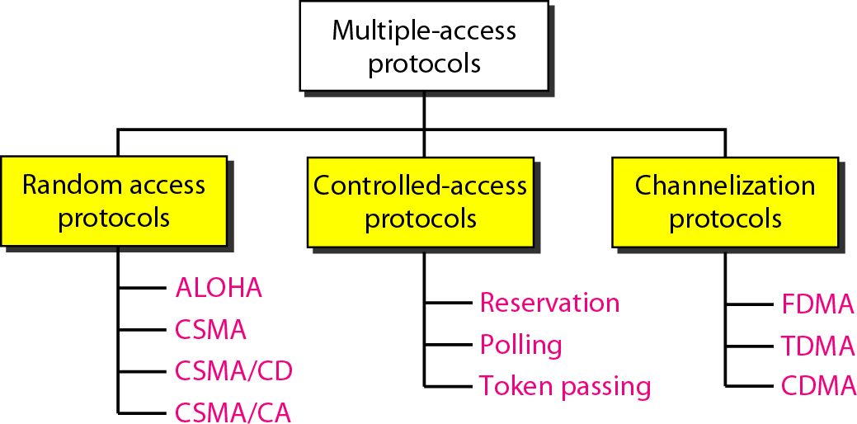
Taxonomy of multiple-access protocols discussed in this chapter

Slide 4

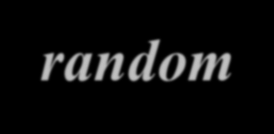
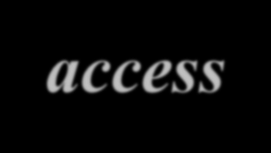
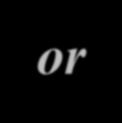
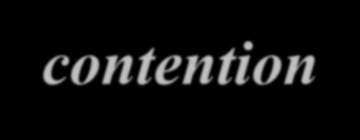
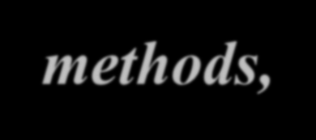

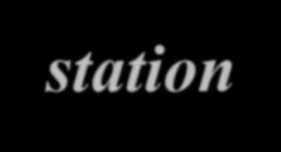


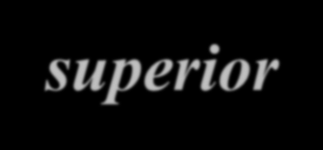

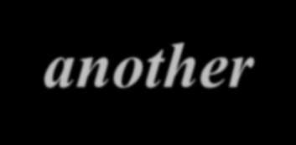
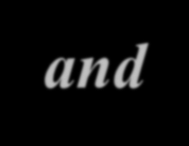
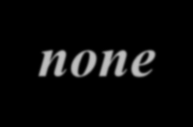

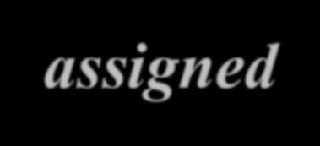
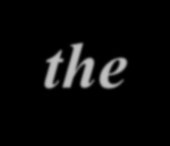
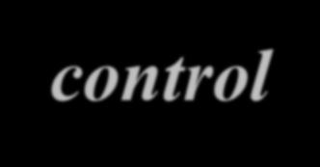

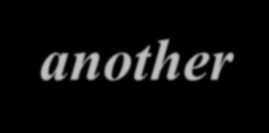

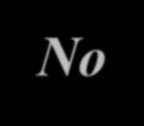
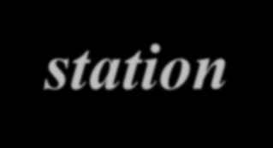
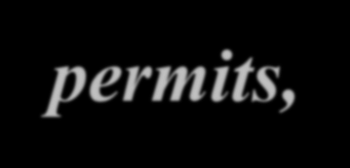
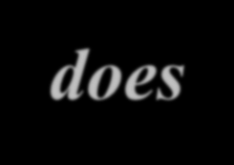
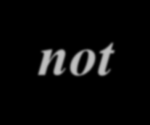
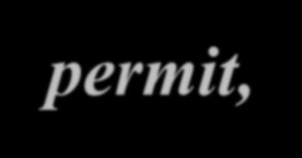
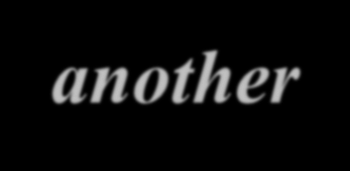


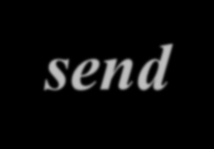
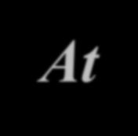
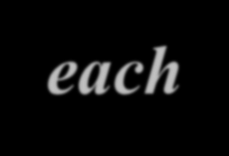
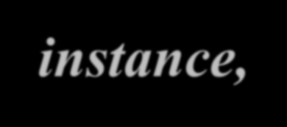
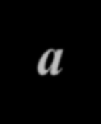
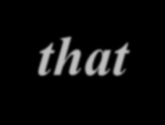
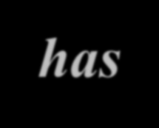
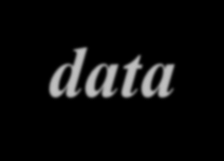
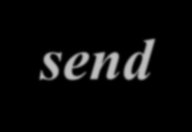
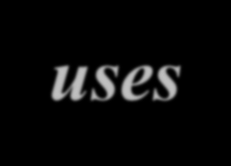

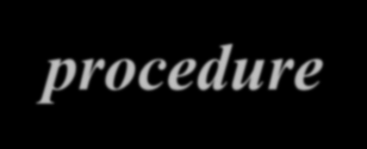
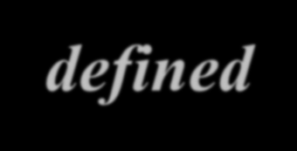

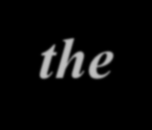
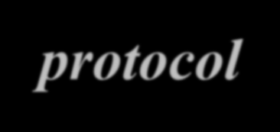
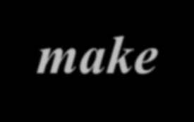
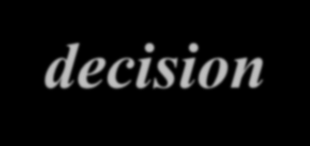

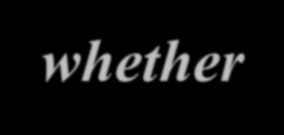

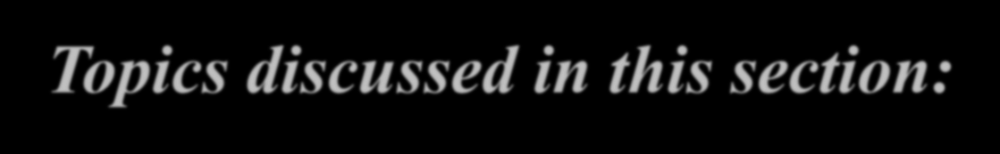
RANDOM ACCESS
In random access or contention methods, no station is superior to another station and none is assigned the control over another. No station permits, or does not permit, another station to send. At each instance, a station that has data to send uses a procedure defined by the protocol to make a decision on whether or not to send.
Topics discussed in this section:
ALOHA
Carrier Sense Multiple Access
Carrier Sense Multiple Access with Collision Detection Carrier Sense Multiple Access with Collision Avoidance

Slide 5
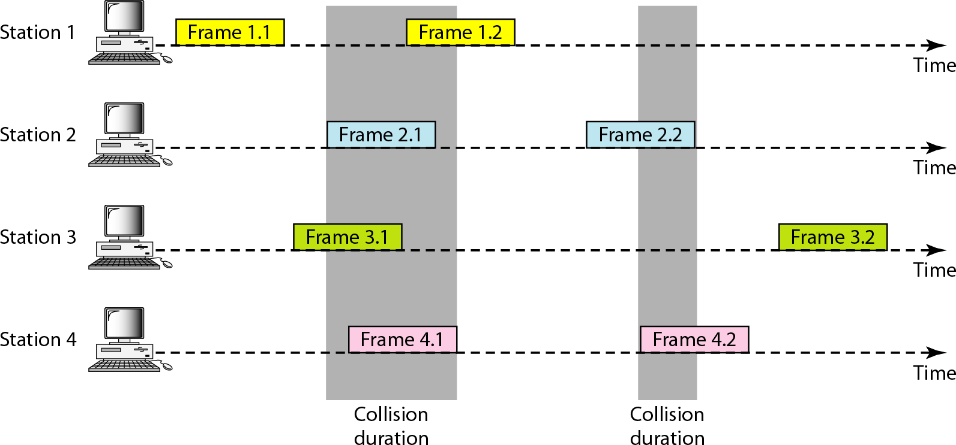
Frames in a pure ALOHA network

Slide 6
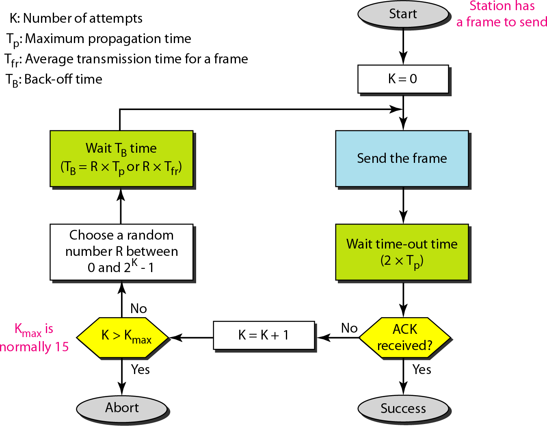
Procedure for pure ALOHA protocol

Slide 7
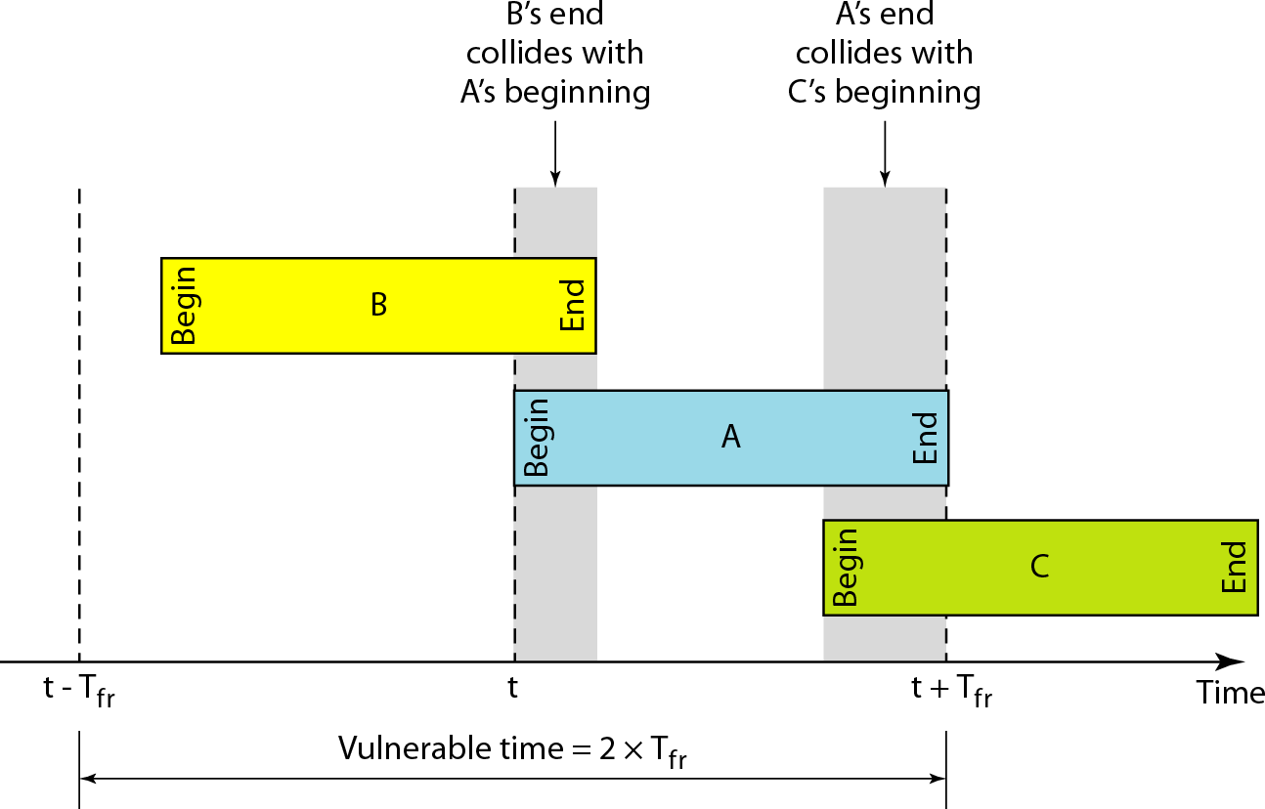
Vulnerable time for pure ALOHA protocol

Slide 8

Note
The throughput for pure ALOHA is S = G × e ^{−2G} .
The maximum throughput S_{max} = 0.184 when G= (1/2).

Slide 9
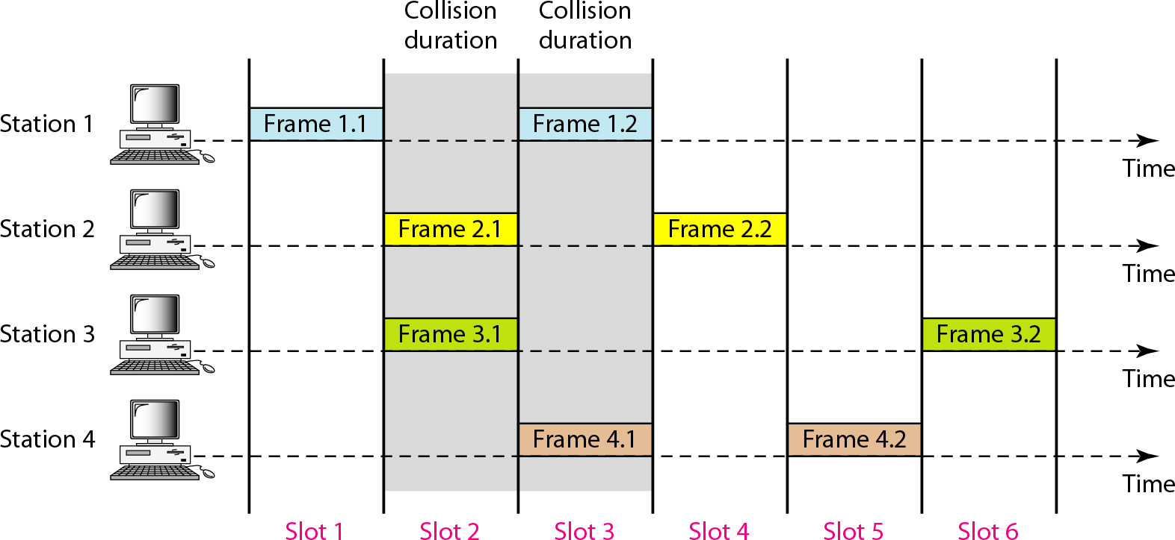
Frames in a slotted ALOHA network

Slide 10
Note
The throughput for slotted ALOHA is S = G × e^{−G} .
The maximum throughput S_{max} = 0.368 when G = 1.

Slide 11
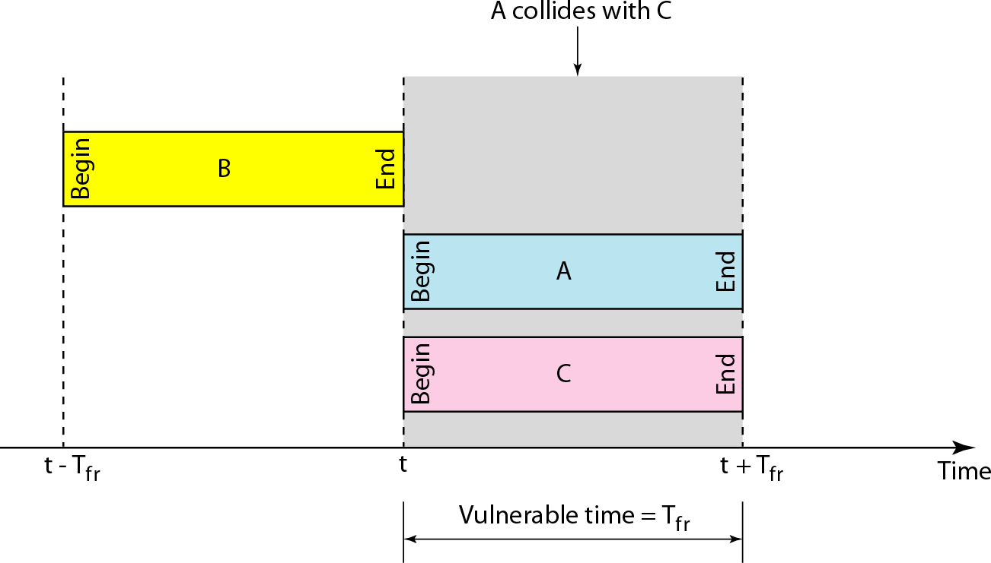
Vulnerable time for slotted ALOHA protocol

Slide 12
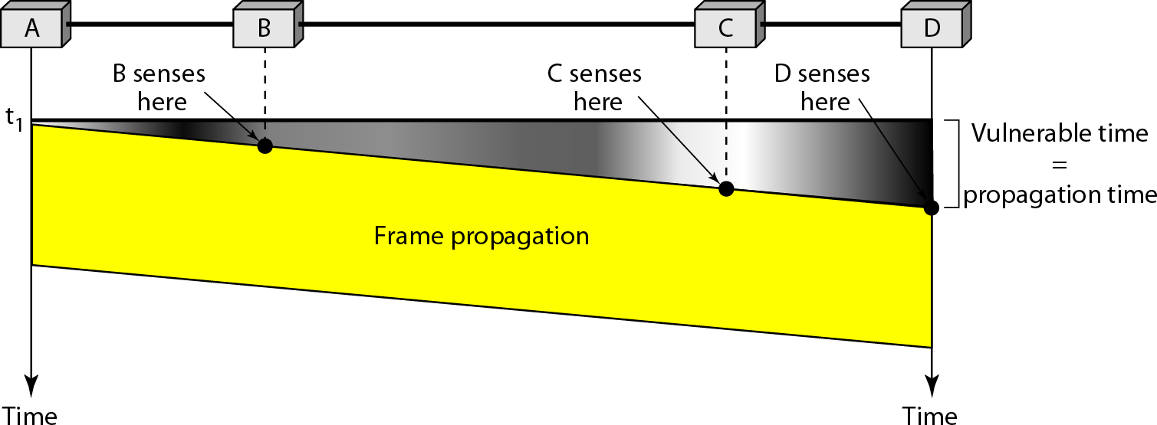
Vulnerable time in CSMA

Slide 13
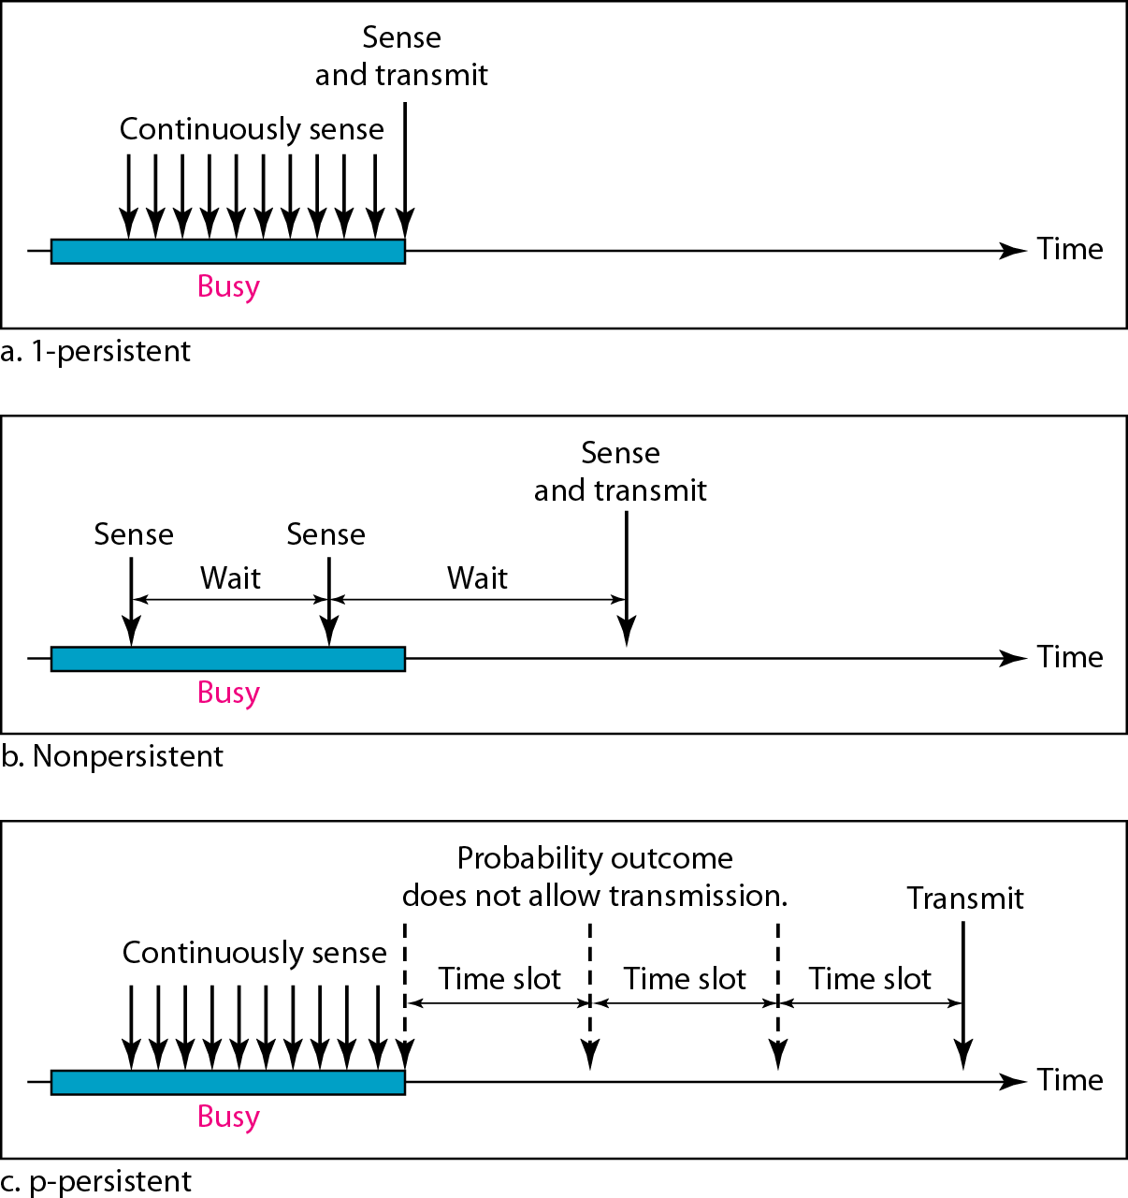
Behavior of three persistence methods

Slide 14
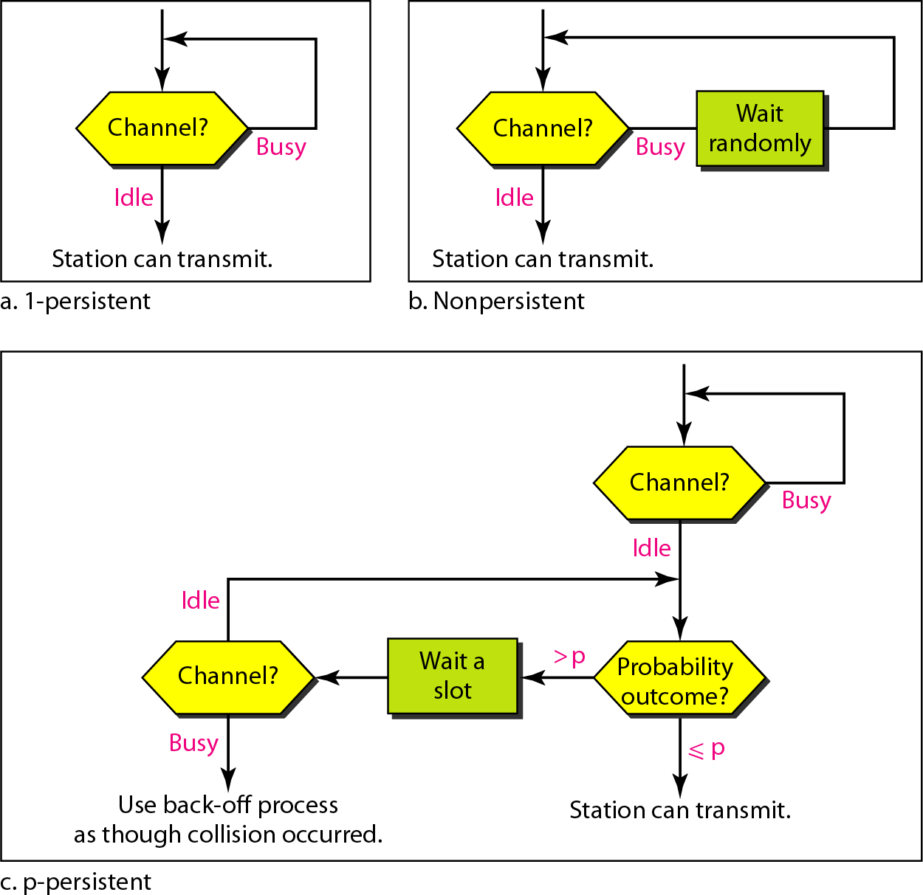
Flow diagram for three persistence methods

Slide 15
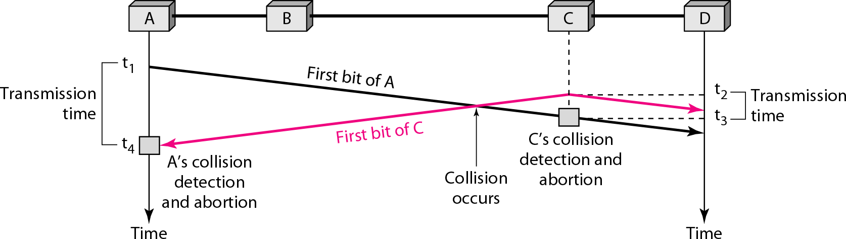
Collision of the first bit in CSMA/CD

Slide 16

Collision and abortion in CSMA/CD

Slide 17

Flow diagram for the CSMA/CD

Slide 18

Energy level during transmission, idleness, or collision

Slide 19

Timing in CSMA/CA

Slide 20
Note
In CSMA/CA, the IFS can also be used to define the priority of a station or a frame.

Slide 21
Note
In CSMA/CA, if the station finds the channel busy, it does not restart the timer of the contention window;
it stops the timer and restarts it when the channel becomes idle.

Slide 22

Flow diagram for CSMA/CA

Slide 23




































12-2 CONTROLLED ACCESS
In controlled access, the stations consult one another to find which station has the right to send. A station cannot send unless it has been authorized by other stations. We discuss three popular controlled-access methods.
Topics discussed in this section:
Reservation Polling
Token Passing

Slide 24

Reservation access method

Slide 25

Select and poll functions in polling access method

Slide 26

Logical ring and physical topology in token-passing access method

